Slide 1
LPS/LDR Data Processing Workshop 10th March 2015
Liz Stanley
Zoe Hall
Albert Koulman
Luke Marney

Slide 2
Data Processing Workshop (refreshments provided!)
Software requirements
Brief comment on R
Converting files
GitHub repository
DIMS processing using HRMS.R script
Writing your own lipid-list
Setting up the processing workflow
The output
Data post-processing (clean-up procedures)
Epidemiology studies
Single plate investigations
LCMS processing using xcms (Zoe)

Slide 3
Brief comment on R and R studio
There are plenty of books, courses and websites available for R
R for Dummies is a good place to start
There are lots of forums, questions and blogs available:
Quick R at http://www.statmethods.net/
R bloggers at http://www.r-bloggers.com/
Notes and examples from 2 University of Cambridge courses are available on the LPS Group share at:
O:\Groups\LPS\Basic_R_courses_Univesity of Cambridge
If you are particularly interested in R, speak to James Smith or Animesh.

Slide 4
Software requirements
File converter MSCONVERT
Available from proteowizard
http://proteowizard.sourceforge.net/downloads.shtml
R and R studio
R Available from http://www.r-project.org/
R Studio Available from http://www.rstudio.com/
R packages
available from http://www.bioconductor.org/
xcms
Rcpp
mzR
data.table
R scripts and lipid lists
Updated versions are available on GitHub https://github.com/
For the purposes of today all scripts and data sets are provided
O:\Groups\LPS\BioComputing\Data_processing work shop_10Mar2015

Slide 5
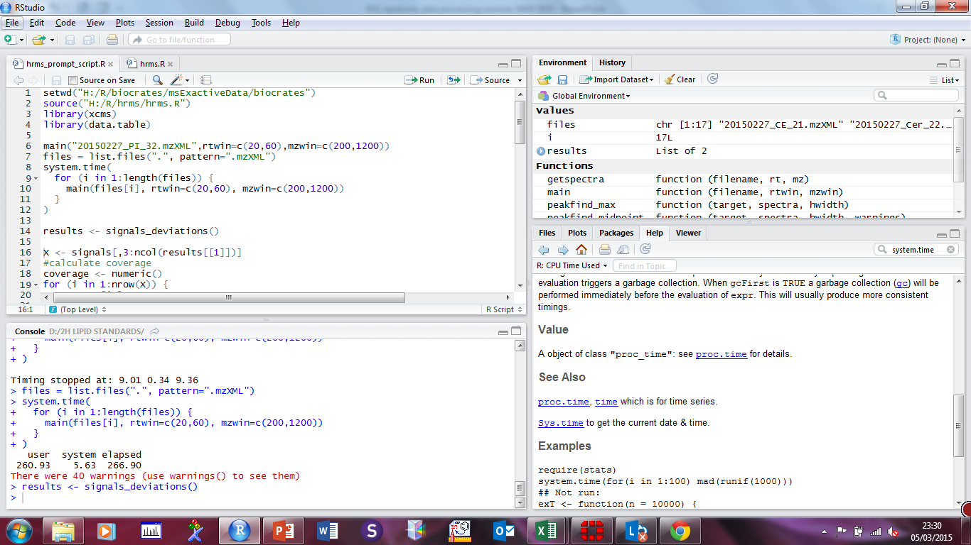
R studio 4 windows
Environment
Script
Packages, plots etc
Console

Slide 6
R Packages Installation guidelines
data.table (within R)
install.packages("data.table")
xcms
source("http://bioconductor.org/biocLite.R")
biocLite("xcms")
mzR
source("http://bioconductor.org/biocLite.R")
biocLite("mzR")
Rcpp
install.packages("Rcpp")

Slide 7
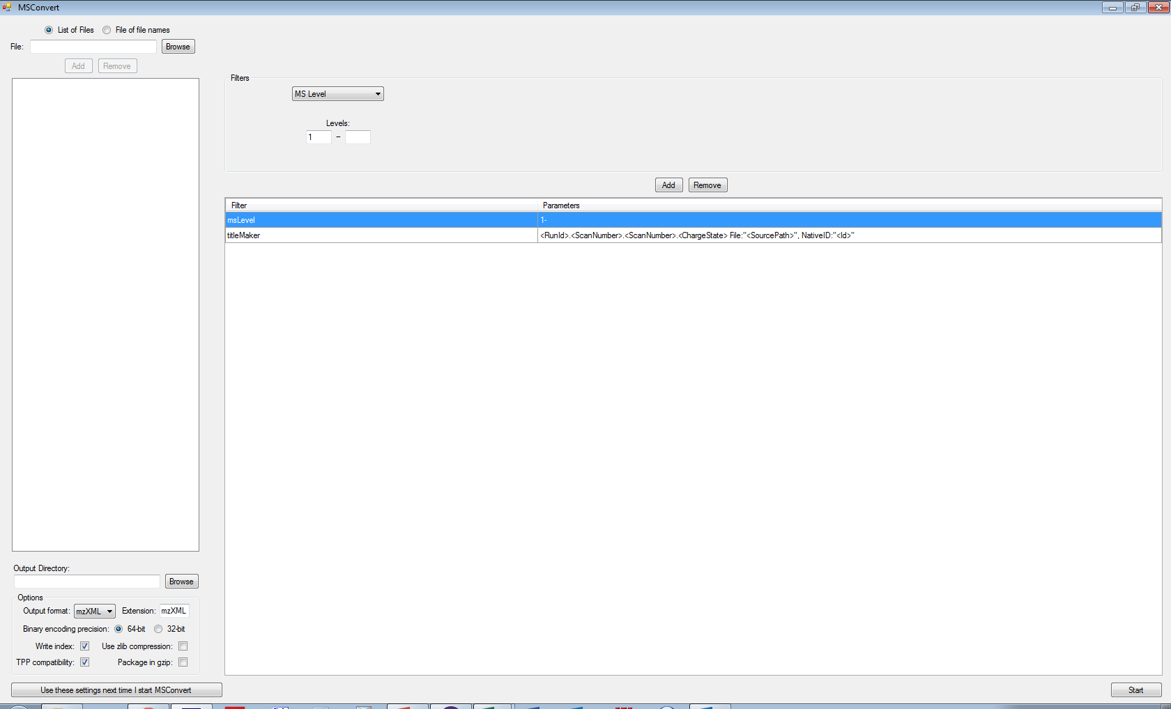
Converting files to the .mzXML format - MSConvert
1
.raw files = input
MS level 1
3
2
.mzXML files = output (this is where you will process the data)
4

Slide 8
Direct infusion spectra (plasma)
Positive mode
Cholesterol and CE
Cer and SM
TG and DG
Lyso-PC
PC, PE, PA, PS, PI, PG
Negative mode
FFA
Cer and SM
Lyso-PC
PC, PE, PA, PS, PI, PG
Positive mode
Negative mode
Chromatogram

Slide 9
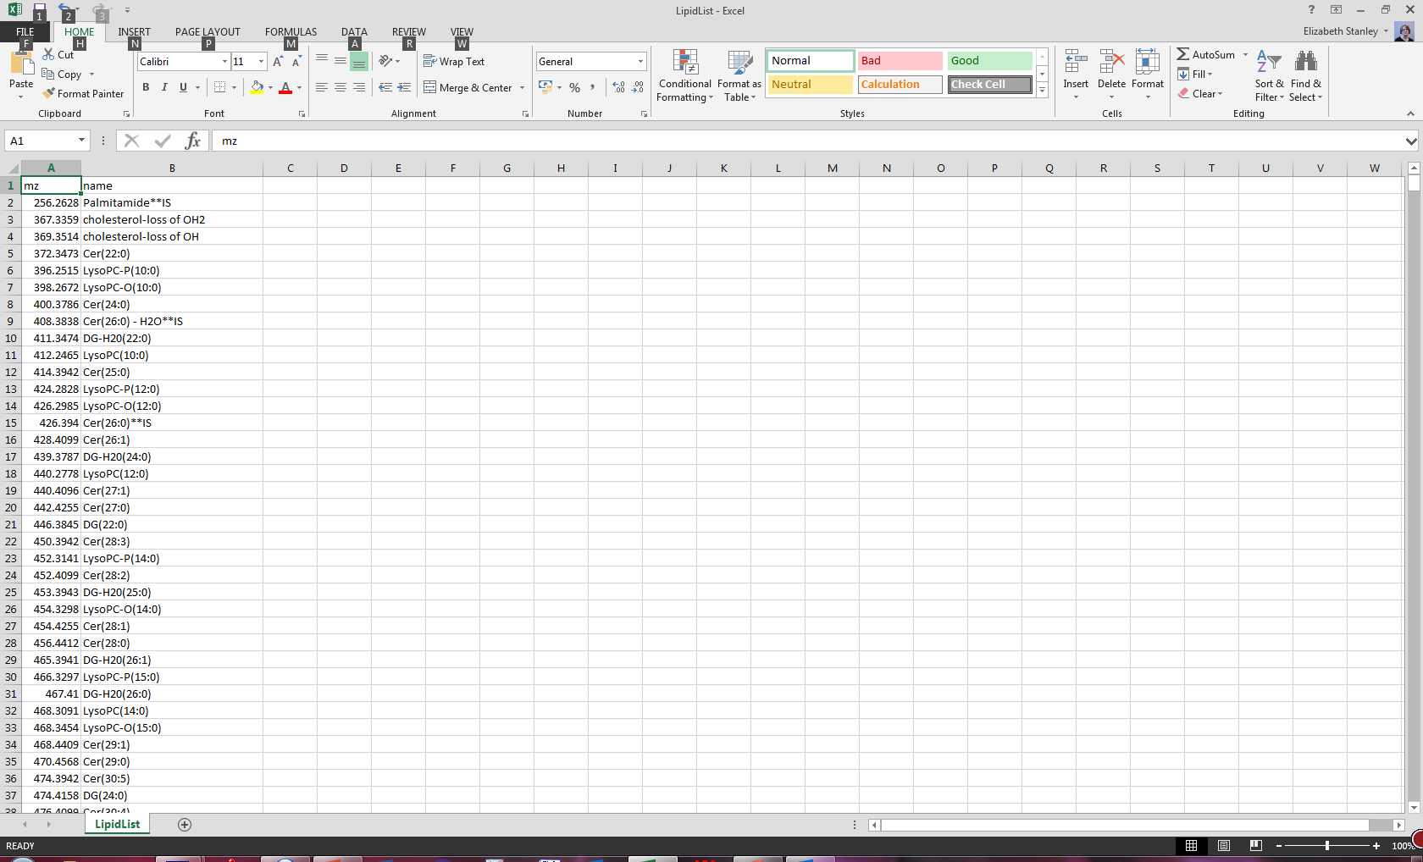
The lipid list (LipidList.csv)

Slide 10
Setting up the working directory for DIMS processing
Your working directory should contain the following items:
mzXML files
HRMS.R script
HRMS_prompt.R script
LipidList.csv

Slide 11
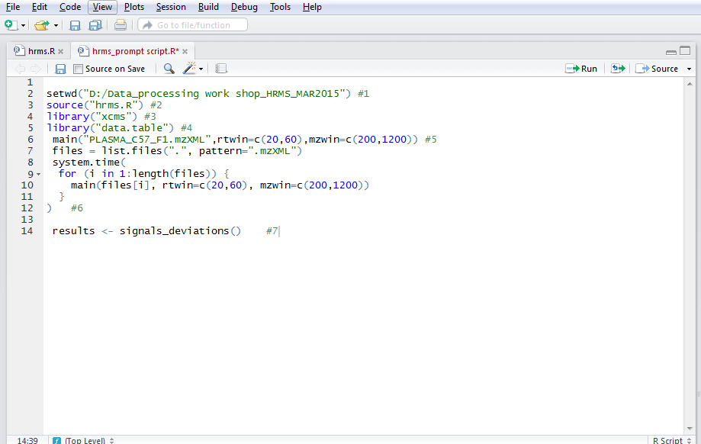
The hrms.R script
Open R Studio and open the hrms_prompt_script

Slide 12
The hrms.R script Setting up
Step #1 Set your working directory
>setwd(“C:/wd_name”) this is where your mzXML files are stored
Step #2 Source the HRMS.R file
> source(“hrms.R”) loads the HRMS.R processing script
Steps #3 & 4 load the xcms and data.table packages
> library(xcms)
> library(data.table)
(mzR and Rcpp will load automatically with xcms)

Slide 13
The hrms.R script Processing the 1st spectrum
Step #5 process the 1st spectrum
> main(“filename1.mzXML",rtwin=c(20,60),mzwin=c(200,1200))
The output is a .csv file which contains the following:
targets.name
targets.m/z
nearest_mz
mz_deviation
signal
RT window (in seconds)
20-60s for positive mode
80-120s for negative mode
mz window
200-1200 for positive mode
185-1200 for negative mode

Slide 14
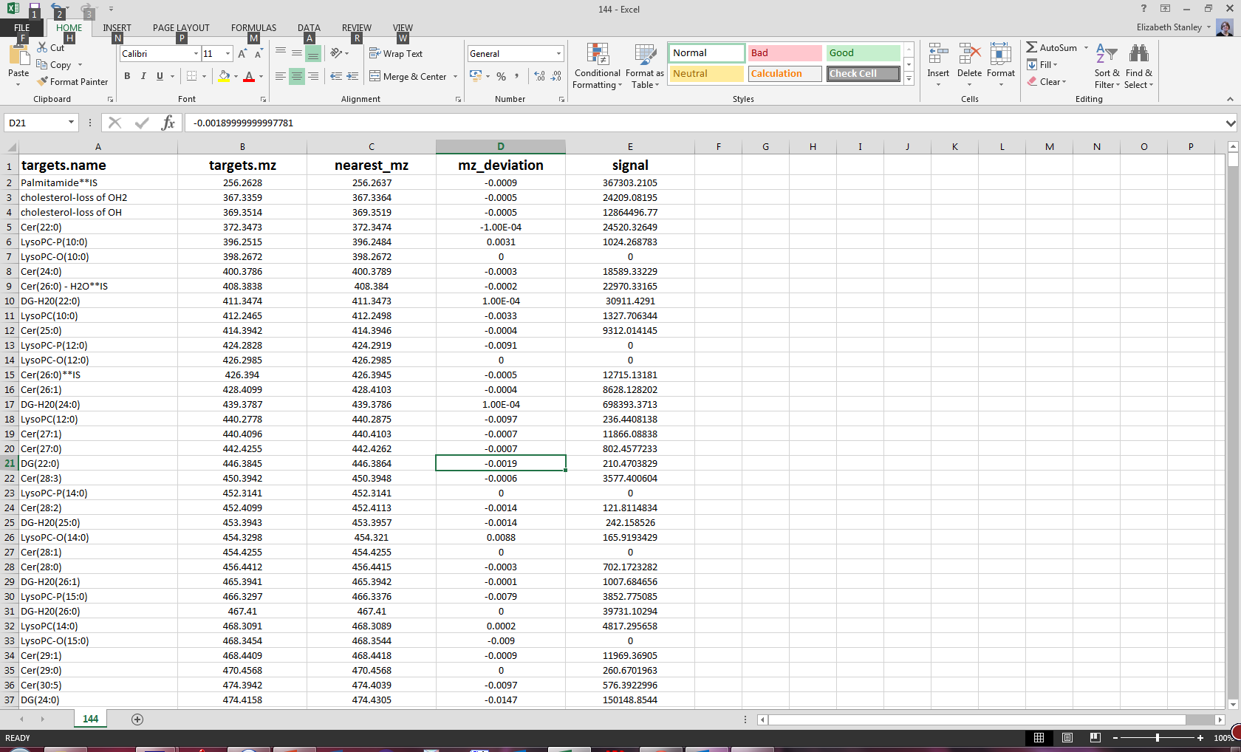
The hrms.R script the .csv file

Slide 15
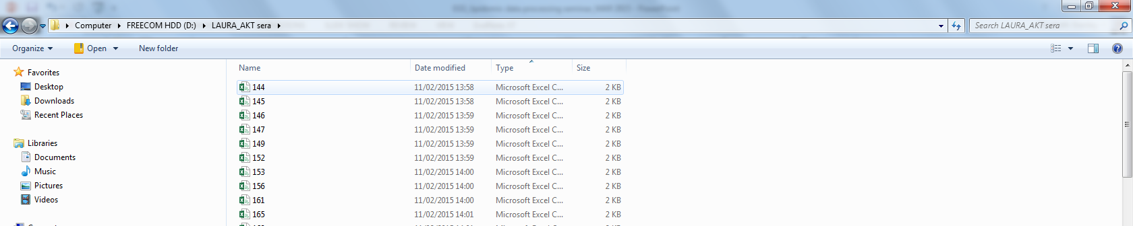
The hrms.R script processing all files
Step #6 processing loop for all files
>files = list.files(".", pattern=".mzXML")
system.time(
for (i in 1:length(files)) {
main(files[i], rtwin=c(20,60), mzwin=c(200,1200))
}
)
Produces .csv file for each spectrum

Slide 16
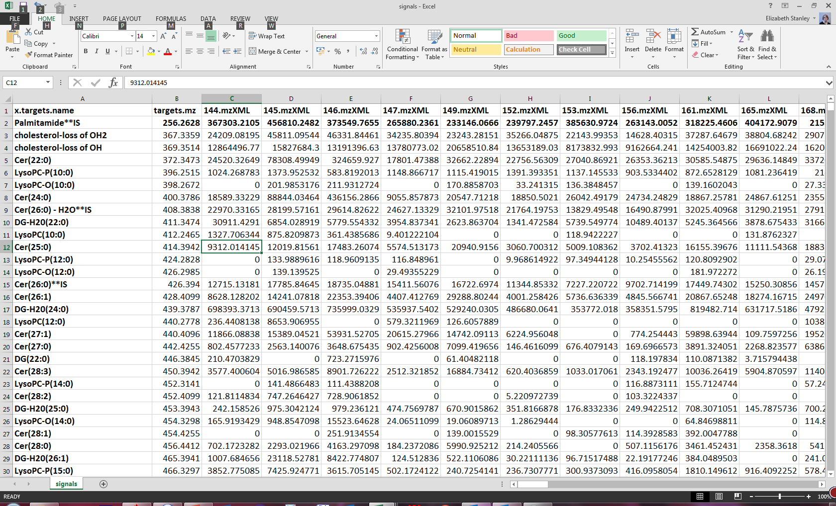
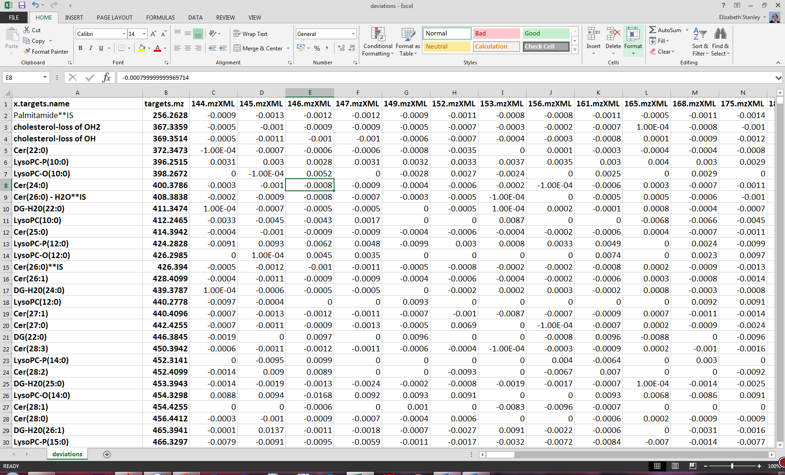
The hrms.R script producing a data matrix
Step #7 signal and deviation .csv files
>results <- signals_deviations()
Produces 2 .csv files one for signals and a second for deviations
signals
deviations

Slide 17
Fenland
Data clean-up 1
AK method
Fenland Cohort 1
Exactive methods
1500 samples
19 plates
4 x 3 QC + 4 blanks on each plate
96*19 = 1824 runs
25.5 GB data
97 bad infusion ( 5.3%)
Data processed using cut-offs
Signal: 1000
Coverage: 60%
De-isotope
Result = 665 variables
Slide courtesy of AK group talk 05 Nov 2014

Slide 18
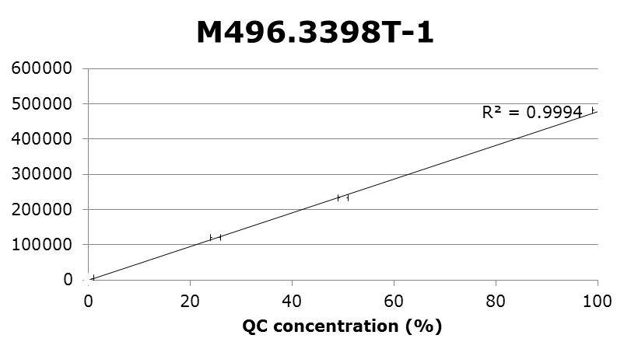
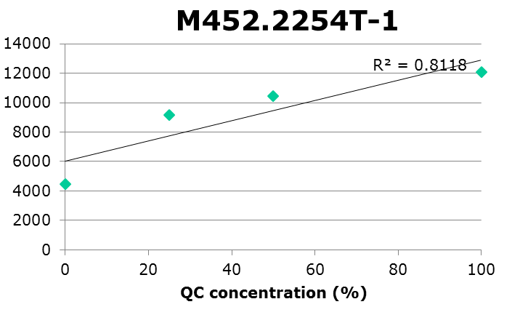
First data clean-up
Data clean-up 1
AK method – QCs
3 levels QC (level 1: undiluted; 2: 1/1 diluted with PBS, 3: 1/4 dilute with PBS)
For each signal averages across QCs and blank
QC 1 level at least 2x blank level and R²> 0.8
Slides courtesy of AK group talk 05 Nov 2014

Slide 19
Normalisation
Normalisation
AK method
After data clean-up: 332 signals
Sum of the intensities of 332 signals determined (total clean signal: TCS)
Average TCS of QC1 determined.
All samples (including QCs and blanks) with TCS lower than average QC1-1.6*SD were omitted
Of the original 1500 samples 1423 remained (95%)
Slide courtesy of AK group talk 05 Nov 2014

Slide 20
Data quality
Data Quality
AK method
332 signals
Average CV of QC1: 17.0%
Mean CV of QC1: 14.9%
Signals with CV < 25%: 285
Signals with CV < 20%: 236
Slide courtesy of AK group talk 05 Nov 2014

Slide 21
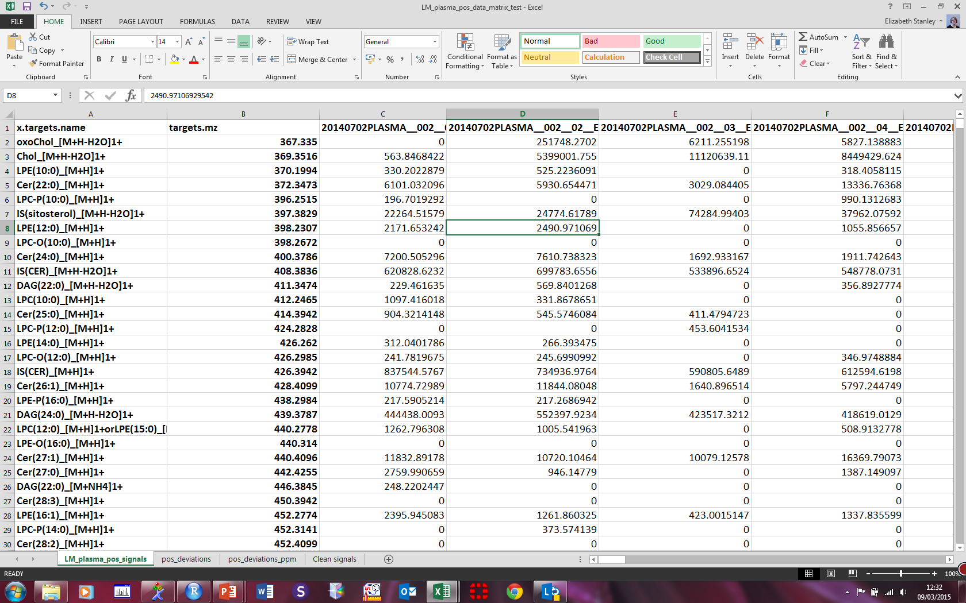

Data clean up 2 (ES) Using the deviation data
Pick peaks that lie within a ±5 ppm window of the target mass
Also pick peaks that are present in a certain number (75-90%) of your samples (or pools or QCs if used).
To calculate Δppm = $\frac{1x106(Theoretical mass − Measured mass) }{Theoretical mass}$
Using the logical commands IF and AND
=IF(AND(pos_dev_ppm!C2>=-5,pos_dev_ppm!C2<=5),LM_plasma_pos_signals!C2,0)
Only allows the entry of intensity data (clean signals) into a new spreadsheet only if the deviations lie between ±5 ppm

Slide 22
Data clean up 2 (ES) Data quality and normalistion
In positive mode
Originally pick 1194 peaks with the lipid list
Reduced to 180 peaks after clean up (5ppm window, present in 75% of samples)
Data can be normalised:
To TCS as before
To standard normal variate (SNV)
Subtraction of the mean intensity of all variables for each peak
Followed by division of the standard deviation
x_{ik =} [( x_{ik -} ‾x_{i} ) / √(Σ( x_{ik} -‾x_{i} )²)] * √(K-1)
Reference: Barnes, R.J., Dhanoa, M.S., and Lister, S.J., (1989), Standard Normal Variate Transformation and De-trending of Near-Infrared Diffuse Reflectance Spectra, Applied Spectroscopy, 43, 772-777.
To IS (single IS or one for each class)

Slide 23
Other processing methods for DIMS data
We have another script available for processing DIMS data (Jagpreet Singh)
This picks all peaks above a pre-set intensity threshold (e.g. 1000)
There is no automatic assignment function
Useful script if you suspect you have unknowns or novel lipids
If you are interested, speak to Albert

